Slide 1
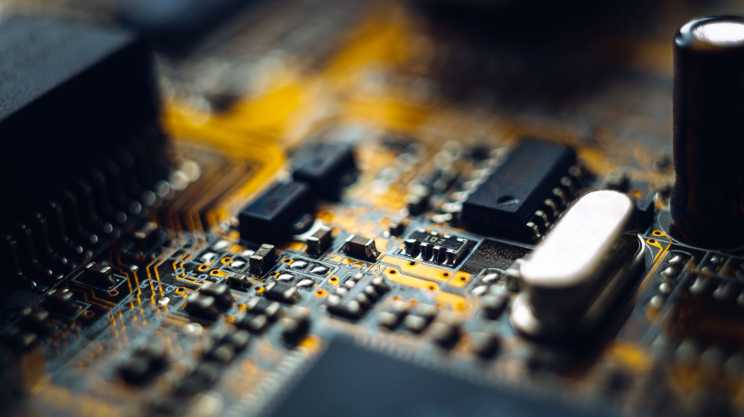
Smart Intrusion Detection (Smart Building)
By Alekhya Pingali

Slide 2

Domain Of Intrusion Detection
The Domain of my project application is the Smart Building.
Security is one of the most imperative aspects of any system. The purpose of doing security intrusion detection is to protect the entire system from external and internal risks.
The main object to design intrusion detection is to alert the owner remotely of the intruder break in by sending the message

Slide 3
Purpose of Smart Intrusion Detection
Security is a crucial and critical issue in a home environment. Many homeowners are concerned about unauthorized access into their homes. Security refers to the detection of malicious behaviors, like for example burglars, unauthorized access to the smart home environment.
Protection against intruders who attempt to penetrate the house for the purpose of theft for example is crucial to have. Intrusion detection system is used as a line of defense to protect the Smart Home/Smart Building because once an intrusion is detected, a response can then take place to minimize damages. In case that an intruder succeeds in his attack over the Smart building, intrusion detection systems (IDS) can detect this attack and send an alarm notification to the owners to stop the activities of the intruder.

Slide 4

Components of Smart Intrusion system
The following are the components for the intrusion detection system:
PIR motion sensor
LED lights
ESP32
Mosquitto( MQTT broker)
MySQL database
Node-red (MQTT Client)
Buzzer

Slide 5
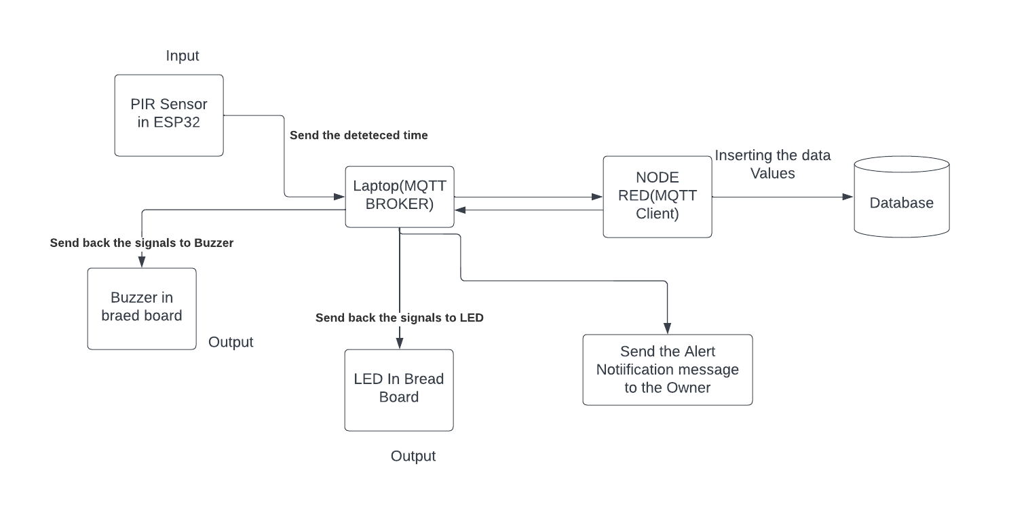
Overall Architecture of Smart Intrusion Detection

Slide 6

Protocols
Mqtt
Mysql

Slide 7
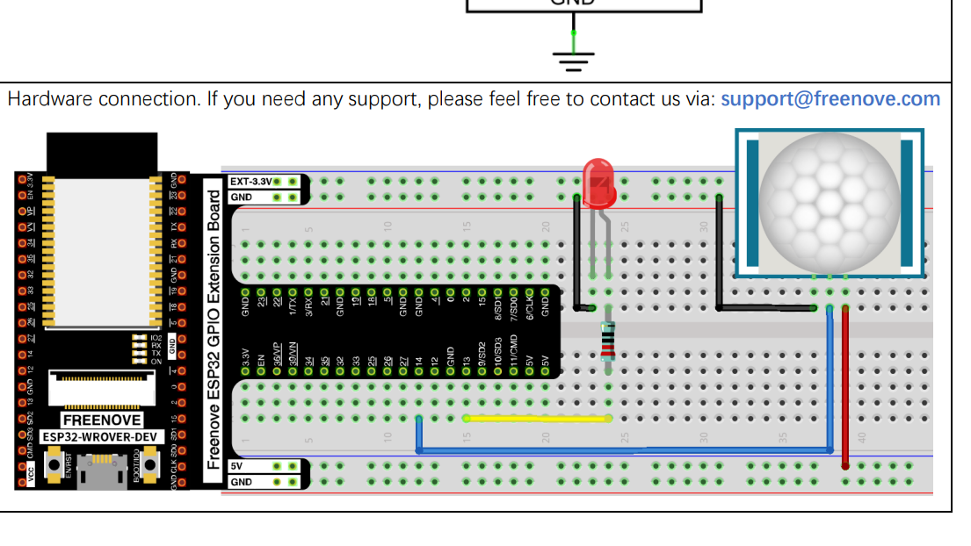
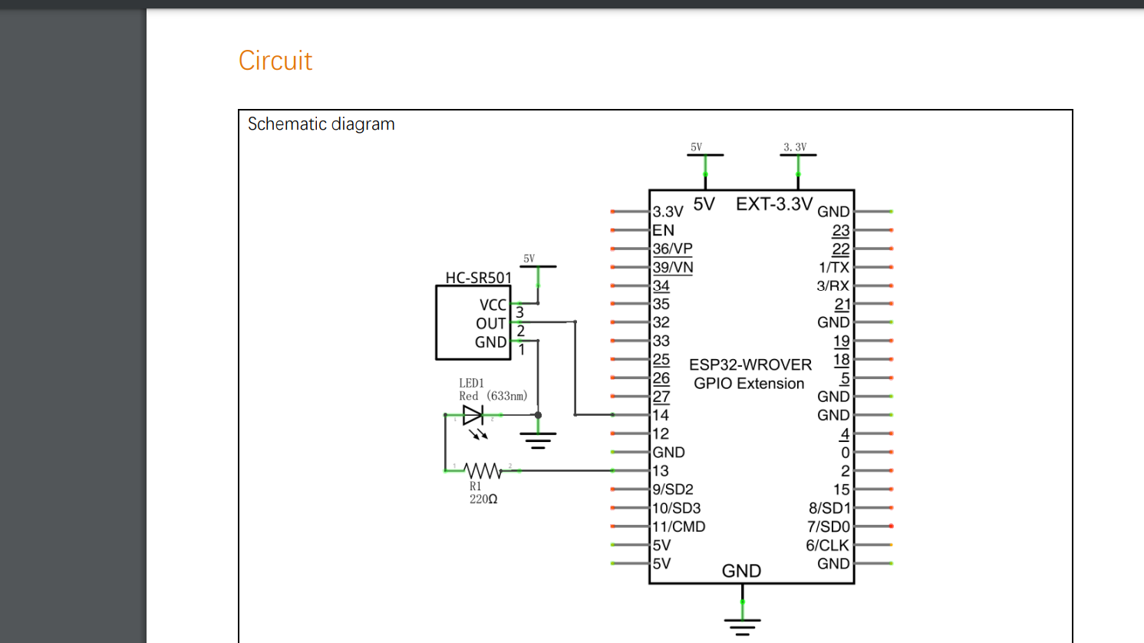
Circuit Diagram

Slide 8

Implemenatation
I have added Buzzer along with LED. Message is also sent to the owner of the building for further security.
I have added both the Led and Buzzer due to which if the owner unable to hear then he can identify by using LED.

Slide 9

Thank You

